Slide 1
Chapter 3
Computer Abstractions and Technology
Arithmetic for Computers (cont.)

Slide 2
So far….
Number representation
Sign Extend/Unsigned
2’s complement
Operations on integers
Addition and subtraction
Multiplication
Today....
Division
Dealing with overflow
Floating-point real numbers
Representation and operations

Slide 3
Division
Check for 0 divisor
Long division approach
If divisor ≤ dividend bits
1 bit in quotient, subtract
Otherwise
0 bit in quotient, bring down next dividend bit
Restoring division
Do the subtract, and if remainder goes < 0, add divisor back
Signed division
Divide using absolute values
Adjust sign of quotient and remainder as required
Remainder has always the same sign of the dividend.
§3.4 Division
quotient
dividend
1001
1000 1001010
-1000
10
101
1010
-1000
10
divisor
remainder
n-bit operands yield n-bit quotient and remainder

Slide 4
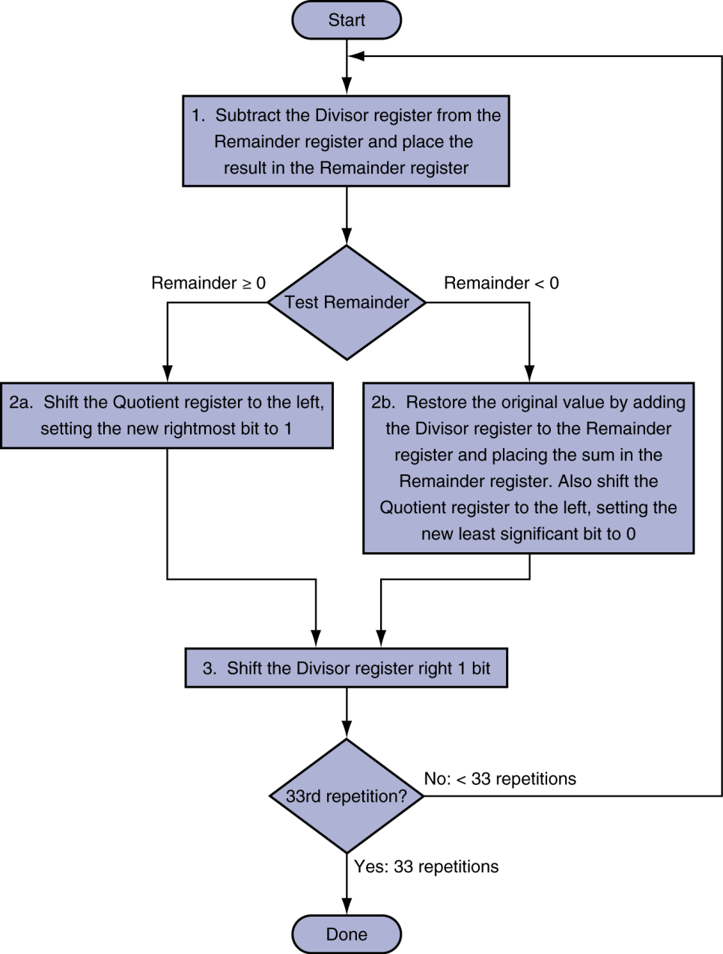
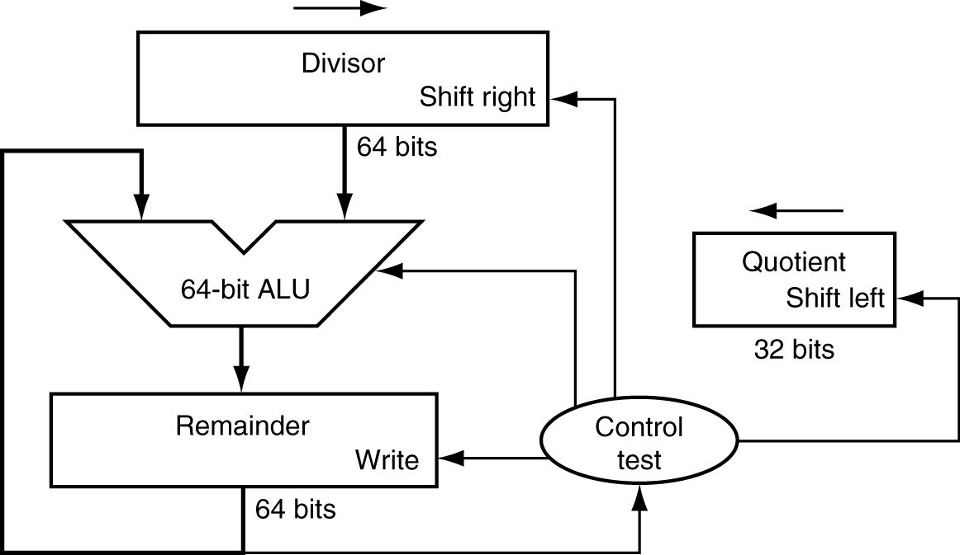
Division Hardware
Initially divisor in left half
Initially dividend

Slide 5
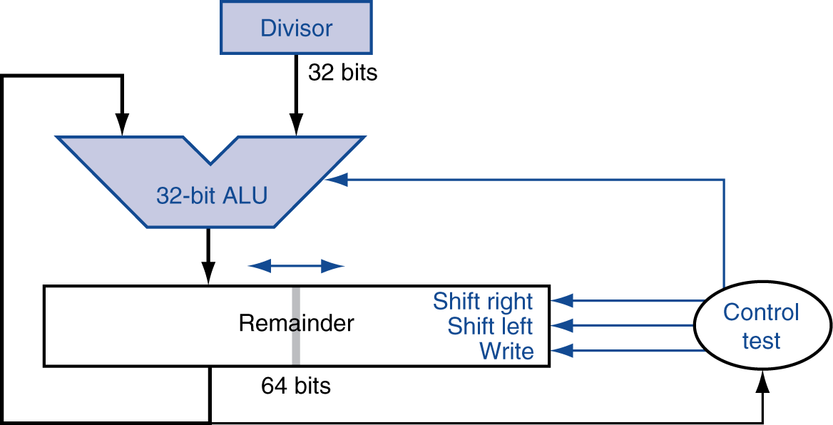
Optimized Divider
One cycle per partial-remainder subtraction
Looks a lot like a multiplier!
Same hardware can be used for both

Slide 6
Faster Division
Can’t use parallel hardware as in multiplier
Subtraction is conditional on sign of remainder
Faster dividers (e.g. SRT division) generate multiple quotient bits per step
SRT division technique:
Guess several quotient bits per step using a table lookup based on the upper bits of the dividend and remainder
Still require multiple steps

Slide 7
MIPS Division
Use HI/LO registers for result
HI: 32-bit remainder
LO: 32-bit quotient
Instructions
div rs, rt / divu rs, rt
No overflow or divide-by-0 checking
Software must perform checks if required
Use mfhi, mflo to access result

Slide 8
MIPS Division
Use HI/LO registers for result
HI: 32-bit remainder
LO: 32-bit quotient
Instructions
div rs, rt / divu rs, rt
No overflow or divide-by-0 checking
Software must perform checks if required
Use mfhi, mflo to access result

Slide 9
Floating Point
Representation for non-integral numbers
Including very small and very large numbers
Like scientific notation
–2.34 × 10⁵⁶
+0.002 × 10^{–4}
+987.02 × 10⁹
In binary
±1.xxxxxxx₂ × 2^{yyyy}
Types float and double in C
§3.5 Floating Point
normalized
not normalized

Slide 10
Floating Point Standard
Defined by IEEE Std 754-1985
Developed in response to divergence of representations
Portability issues for scientific code
Now almost universally adopted
Two representations
Single precision (32-bit)
Double precision (64-bit)

Slide 11
IEEE Floating-Point Format
single: 8 bits double: 11 bits
single: 23 bits double: 52 bits
S
Exponent
Fraction
S: sign bit (0 ⇒ non-negative, 1 ⇒ negative)
Normalize significand: 1.0 ≤ |significand| < 2.0
Always has a leading pre-binary-point 1 bit, so no need to represent it explicitly (hidden bit)
Significand is Fraction with the “1.” restored
Exponent: excess representation: actual exponent + Bias
Ensures exponent is unsigned
Single: Bias = 127; Double: Bias = 1023
Special case: the 0.0 is represented with all 0’s

Slide 12
Single-Precision Range
Exponents 00000000 and 11111111 reserved
Smallest value
Exponent: 00000001 ⇒ actual exponent = 1 – 127 = –126
Fraction: 000…00 ⇒ significand = 1.0
±1.0 × 2^{–126} ≈ ±1.2 × 10^{–38}
Largest value
exponent: 11111110 ⇒ actual exponent = 254 – 127 = +127
Fraction: 111…11 ⇒ significand ≈ 2.0
±2.0 × 2⁺¹²⁷ ≈ ±3.4 × 10⁺³⁸

Slide 13
Double-Precision Range
Exponents 0000…00 and 1111…11 reserved
Smallest value
Exponent: 00000000001 ⇒ actual exponent = 1 – 1023 = –1022
Fraction: 000…00 ⇒ significand = 1.0
±1.0 × 2^{–1022} ≈ ±2.2 × 10^{–308}
Largest value
Exponent: 11111111110 ⇒ actual exponent = 2046 – 1023 = +1023
Fraction: 111…11 ⇒ significand ≈ 2.0
±2.0 × 2⁺¹⁰²³ ≈ ±1.8 × 10⁺³⁰⁸

Slide 14
Floating-Point Precision
Relative precision
all fraction bits are significant
Single: approx 2^{–23}
Equivalent to 23 × log₁₀2 ≈ 23 × 0.3 ≈ 6 decimal digits of precision
Double: approx 2^{–52}
Equivalent to 52 × log₁₀2 ≈ 52 × 0.3 ≈ 16 decimal digits of precision

Slide 15
Floating-Point Example
Represent –0.75
–0.75 = (–1)¹ × 1.1₂ × 2^{–1}
S = 1
Fraction = 1000…00₂
Exponent = –1 + Bias
Single: –1 + 127 = 126 = 01111110₂
Double: –1 + 1023 = 1022 = 01111111110₂
Single: 1011111101000…00
Double: 1011111111101000…00

Slide 16
Floating-Point Example
What number is represented by this single-precision float?
11000000101000…00
S = 1
Fraction = 01000…00₂
Exponent = 10000001₂ = 129
x = (–1)¹ × (1 + 01₂) × 2^{(129 – 127)}
= (–1) × 1.25 × 2²
= –5.0

Slide 17
Denormal Numbers
Exponent = 000...0 ⇒ hidden bit is 0
Smaller than normal numbers
allow for gradual underflow, with diminishing precision
Denormal with fraction = 000...0
Two representations of 0.0!

Slide 18
Infinities and NaNs
Exponent = 111...1, Fraction = 000...0
±Infinity
Can be used in subsequent calculations, avoiding need for overflow check
Exponent = 111...1, Fraction ≠ 000...0
Not-a-Number (NaN)
Indicates illegal or undefined result
e.g., 0.0 / 0.0
Can be used in subsequent calculations

Slide 19
Floating-Point Addition – Example 1
Consider a 4-digit decimal example
9.999 × 10¹ + 1.610 × 10^{–1}
Step 1. Align decimal points
Shift number with smaller exponent
9.999 × 10¹ + 0.016 × 10¹
Step 2. Add significands
9.999 × 10¹ + 0.016 × 10¹ = 10.015 × 10¹
Step 3. Normalize result & check for over/underflow
1.0015 × 10²
Step 4. Round and renormalize if necessary
1.002 × 10²

Slide 20
Floating-Point Addition – Example 2
Now consider a 4-digit binary example
1.000₂ × 2^{–1} + –1.110₂ × 2^{–2} (0.5 + –0.4375)
Step 1. Align binary points
Shift number with smaller exponent
1.000₂ × 2^{–1} + –0.111₂ × 2^{–1}
Step 2. Add significands
1.000₂ × 2^{–1} + –0.111₂ × 2–1 = 0.001₂ × 2^{–1}
Step 3. Normalize result & check for over/underflow
1.000₂ × 2^{–4}, with no over/underflow
Step 4. Round and renormalize if necessary
1.000₂ × 2^{–4} (no change) = 0.0625

Slide 21
FP Adder Hardware
Much more complex than integer adder
Doing it in one clock cycle would take too long
Much longer than integer operations
Slower clock would penalize all instructions
FP adder usually takes several cycles
Can be pipelined

Slide 22
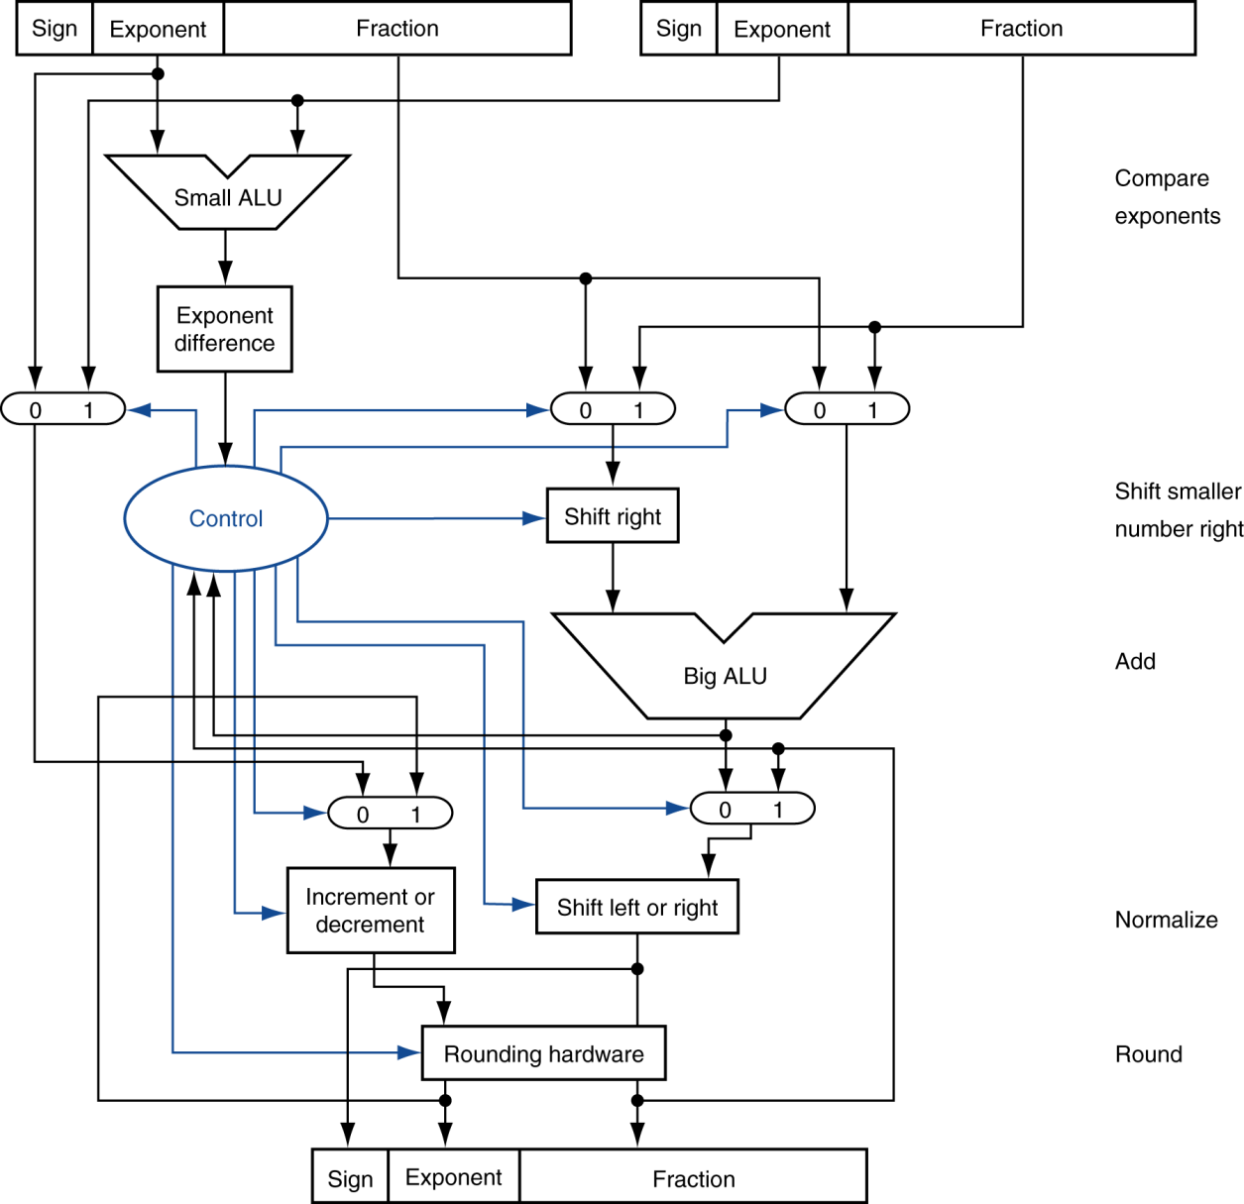
FP Adder Hardware
Step 1
Step 2
Step 3
Step 4

Slide 23
Next time
Continue Floating point arithmetic
Multiplication
Floating Points in MIPS
§3.9 Concluding Remarks

Slide 24
Floating-Point Multiplication
Now consider a 4-digit binary example
1.000₂ × 2^{–1} × –1.110₂ × 2^{–2} (0.5 × –0.4375)
1. Add exponents
Unbiased: –1 + –2 = –3
Biased: (–1 + 127) + (–2 + 127) = –3 + 254 – 127 = –3 + 127
2. Multiply significands
1.000₂ × 1.110₂ = 1.1102 ⇒ 1.110₂ × 2^{–3}
3. Normalize result & check for over/underflow
1.110₂ × 2^{–3} (no change) with no over/underflow
4. Round and renormalize if necessary
1.110₂ × 2^{–3} (no change)
5. Determine sign: +ve × –ve ⇒ –ve
–1.110₂ × 2^{–3} = –0.21875

Slide 25
Floating-Point Multiplication
Consider a 4-digit decimal example
1.110 × 10¹⁰ × 9.200 × 10^{–5}
1. Add exponents
For biased exponents, subtract bias from sum
New exponent = 10 + –5 = 5
2. Multiply significands
1.110 × 9.200 = 10.212 ⇒ 10.212 × 10⁵
3. Normalize result & check for over/underflow
1.0212 × 10⁶
4. Round and renormalize if necessary
1.021 × 10⁶
5. Determine sign of result from signs of operands
+1.021 × 10⁶

Slide 26
FP Arithmetic Hardware
FP multiplier is of similar complexity to FP adder
But uses a multiplier for significands instead of an adder
FP arithmetic hardware usually does
Addition, subtraction, multiplication, division, reciprocal, square-root
FP ↔ integer conversion
Operations usually takes several cycles
Can be pipelined

Slide 27
FP Instructions in MIPS
FP hardware is coprocessor 1
Adjunct processor that extends the ISA
Separate FP registers
32 single-precision: $f0, $f1, … $f31
Paired for double-precision: $f0/$f1, $f2/$f3, …
Release 2 of MIPs ISA supports 32 × 64-bit FP reg’s
FP instructions operate only on FP registers
Programs generally don’t do integer ops on FP data, or vice versa
More registers with minimal code-size impact
FP load and store instructions
lwc1, ldc1, swc1, sdc1
e.g., ldc1 $f8, 32($sp)

Slide 28
FP Instructions in MIPS
Single-precision arithmetic
add.s, sub.s, mul.s, div.s
e.g., add.s $f0, $f1, $f6
Double-precision arithmetic
add.d, sub.d, mul.d, div.d
e.g., mul.d $f4, $f4, $f6
Single- and double-precision comparison
c.xx.s, c.xx.d (xx is eq, lt, le, …)
Sets or clears FP condition-code bit
e.g. c.lt.s $f3, $f4
Branch on FP condition code true or false
bc1t, bc1f
e.g., bc1t TargetLabel

Slide 29
FP Example: °F to °C
C code:
float f2c (float fahr) { return ((5.0/9.0)*(fahr - 32.0)); }
fahr in $f12, result in $f0, literals in global memory space
Compiled MIPS code:
f2c: lwc1 $f16, const5($gp) lwc2 $f18, const9($gp) div.s $f16, $f16, $f18 lwc1 $f18, const32($gp) sub.s $f18, $f12, $f18 mul.s $f0, $f16, $f18 jr $ra

Slide 30
Interpretation of Data
The BIG Picture
Bits have no inherent meaning
Interpretation depends on the instructions applied
Computer representations of numbers
Finite range and precision
Need to account for this in programs

Slide 31
Who Cares About FP Accuracy?
Important for scientific code
But for everyday consumer use?
“My bank balance is out by 0.0002¢!” ☹
The Intel Pentium FDIV bug
The market expects accuracy
See Colwell, The Pentium Chronicles

Slide 32
Concluding Remarks
ISAs support arithmetic
Signed and unsigned integers
Floating-point approximation to reals
Bounded range and precision
Operations can overflow and underflow
MIPS ISA
Core instructions: 54 most frequently used
100% of SPECINT, 97% of SPECFP
Other instructions: less frequent
§3.9 Concluding Remarks

Slide 33
Next Time…
We start Ch 4 and we look in detail at the processor.
HW is due tonight.

Slide 34
FP Example: Array Multiplication
X = X + Y × Z
All 32 × 32 matrices, 64-bit double-precision elements
C code:
void mm (double x[][], double y[][], double z[][]) { int i, j, k; for (i = 0; i! = 32; i = i + 1) for (j = 0; j! = 32; j = j + 1) for (k = 0; k! = 32; k = k + 1) x[i][j] = x[i][j] + y[i][k] * z[k][j]; }
Addresses of x, y, z in $a0, $a1, $a2, and i, j, k in $s0, $s1, $s2

Slide 35
FP Example: Array Multiplication
MIPS code:
li $t1, 32 # $t1 = 32 (row size/loop end) li $s0, 0 # i = 0; initialize 1st for loop L1: li $s1, 0 # j = 0; restart 2nd for loop L2: li $s2, 0 # k = 0; restart 3rd for loop sll $t2, $s0, 5 # $t2 = i * 32 (size of row of x) addu $t2, $t2, $s1 # $t2 = i * size(row) + j sll $t2, $t2, 3 # $t2 = byte offset of [i][j] addu $t2, $a0, $t2 # $t2 = byte address of x[i][j] l.d $f4, 0($t2) # $f4 = 8 bytes of x[i][j] L3: sll $t0, $s2, 5 # $t0 = k * 32 (size of row of z) addu $t0, $t0, $s1 # $t0 = k * size(row) + j sll $t0, $t0, 3 # $t0 = byte offset of [k][j] addu $t0, $a2, $t0 # $t0 = byte address of z[k][j] l.d $f16, 0($t0) # $f16 = 8 bytes of z[k][j] …

Slide 36
FP Example: Array Multiplication
… sll $t0, $s0, 5 # $t0 = i*32 (size of row of y) addu $t0, $t0, $s2 # $t0 = i*size(row) + k sll $t0, $t0, 3 # $t0 = byte offset of [i][k] addu $t0, $a1, $t0 # $t0 = byte address of y[i][k] l.d $f18, 0($t0) # $f18 = 8 bytes of y[i][k] mul.d $f16, $f18, $f16 # $f16 = y[i][k] * z[k][j] add.d $f4, $f4, $f16 # f4=x[i][j] + y[i][k]*z[k][j] addiu $s2, $s2, 1 # $k k + 1 bne $s2, $t1, L3 # if (k != 32) go to L3 s.d $f4, 0($t2) # x[i][j] = $f4 addiu $s1, $s1, 1 # $j = j + 1 bne $s1, $t1, L2 # if (j != 32) go to L2 addiu $s0, $s0, 1 # $i = i + 1 bne $s0, $t1, L1 # if (i != 32) go to L1

Slide 37
Accurate Arithmetic
IEEE Std 754 specifies additional rounding control
Extra bits of precision (guard, round, sticky)
Choice of rounding modes
Allows programmer to fine-tune numerical behavior of a computation
Not all FP units implement all options
Most programming languages and FP libraries just use defaults
Trade-off between hardware complexity, performance, and market requirements

Slide 38
Right Shift and Division
Left shift by i places multiplies an integer by 2^{i}
Right shift divides by 2^{i}?
Only for unsigned integers
For signed integers
Arithmetic right shift: replicate the sign bit
e.g., –5 / 4
11111011₂ >> 2 = 11111110₂ = –2
Rounds toward –∞
c.f. 11111011₂ >>> 2 = 00111110₂ = +62
§3.8 Fallacies and Pitfalls

